Slide 1
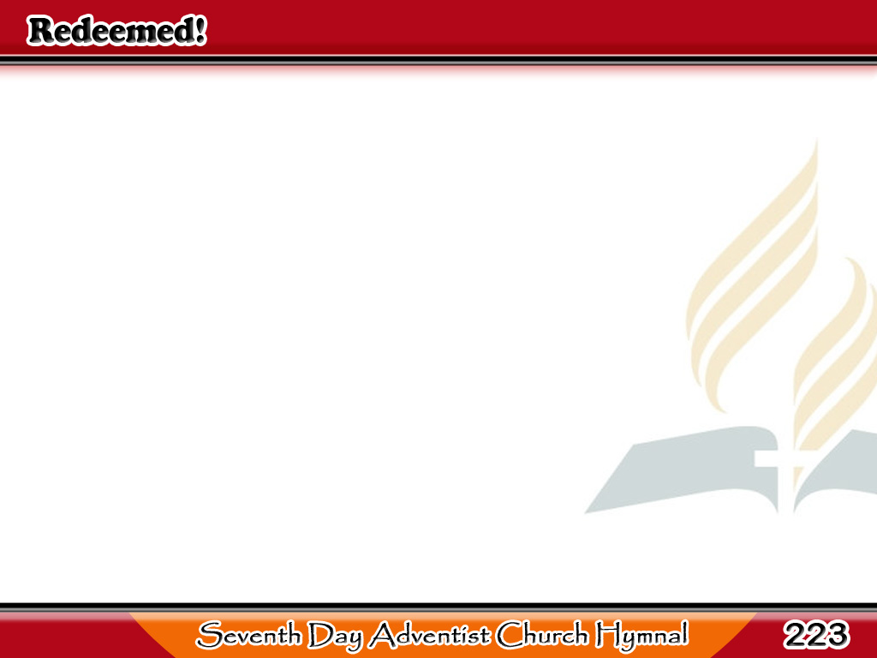
Sa Pamamagitan ng Dugo ng Kordero ay Natubos!
Redeemed!
How I love to proclaim it!
Redeemed by the blood
of the Lamb;
1/3

Slide 2
Sa Pamamagitan ng Dugo ng Kordero ay Natubos!
Redeemed through
His infinite mercy,
His child, and forever, I am.
1/3

Slide 3
-Refrain-
Sa Pamamagitan ng Dugo ng Kordero ay Natubos!
Redeemed, redeemed,
Redeemed by the blood
of the Lamb;
Redeemed, redeemed,
His child, and forever I am.
1/3

Slide 4
Sa Pamamagitan ng Dugo ng Kordero ay Natubos!
Redeemed!
And so happy in Jesus!
No language my rapture can tell;
2/3

Slide 5
Sa Pamamagitan ng Dugo ng Kordero ay Natubos!
I know that the light
of His presence
With me doth continually dwell.
2/3

Slide 6
-Refrain-
Sa Pamamagitan ng Dugo ng Kordero ay Natubos!
Redeemed, redeemed,
Redeemed by the blood
of the Lamb;
Redeemed, redeemed,
His child, and forever I am.
2/3

Slide 7
Sa Pamamagitan ng Dugo ng Kordero ay Natubos!
I know there’s a crown
that is waiting
In yonder bright mansion for me;
3/3

Slide 8
Sa Pamamagitan ng Dugo ng Kordero ay Natubos!
And soon, with the saints
made perfect,
At home with the Lord I shall be.
3/3

Slide 9
-Refrain-
Sa Pamamagitan ng Dugo ng Kordero ay Natubos!
Redeemed, redeemed,
Redeemed by the blood
of the Lamb;
Redeemed, redeemed,
His child, and forever I am.
3/3

